Slide 1
The Burrows-Wheeler Transform for DNA sequence analysis
Ole Schulz-Trieglaff
Computational Biology
Illumina UK
Great Chesterford Research Park

Slide 2
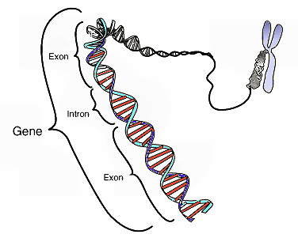
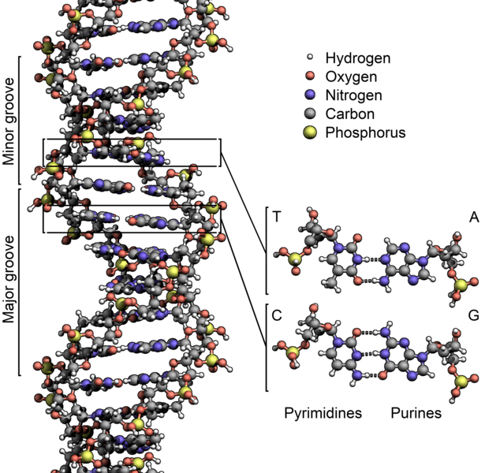
Why DNA sequencing?
Deoxyribonucleic acid (DNA) encodes the genetic instructions guiding the development and functioning of an organism.
Encoded as a sequence of nucleotide molecules (guanine, adenine, thymine, and cytosine) recorded using the letters G, A, T, and C.
Pictures and text taken from wikipedia

Slide 3
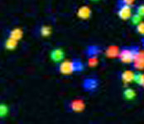

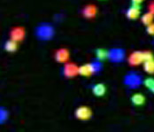
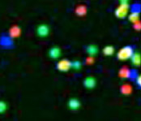
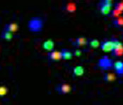

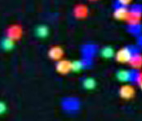
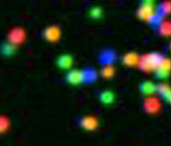
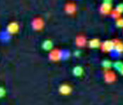
DNA-sequencing by synthesis
3’
5’
A
G
C
T
A
G
C
T
T
C
A
C
G
G
A
T
A
A
T
C
C
C
G
C
G
A
T
T
C
Sample preparation
G
Cluster growth
A
Single molecule array
T
5’
Sequencing
1
2
3
4
5
6
7
8
9
T G C T A C G A T …
Image acquisition
Result is a set of DNA string/reads (length approx 150-200 nucleotides)

Slide 4
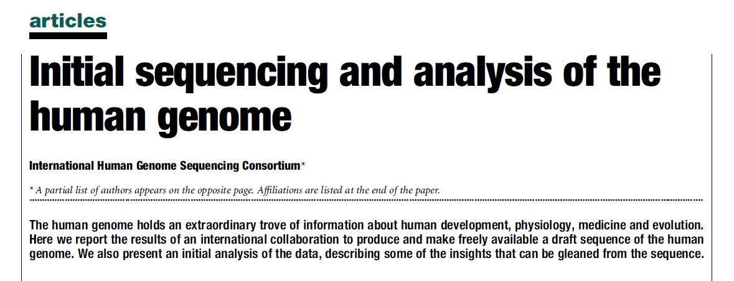
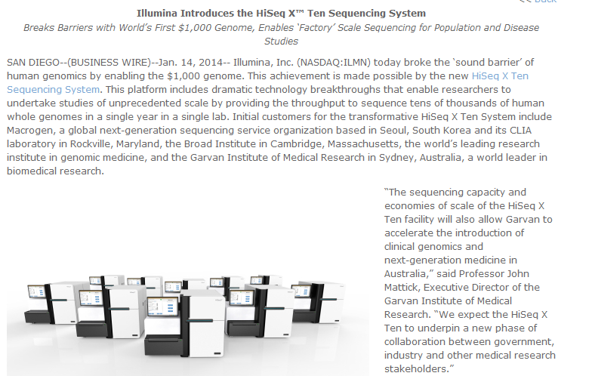
Growth in sequencing data
Nature 409:860-921
2001
10 year international effort
= 22.5 x 10⁹
bases of sequence
2014
HiSeq X ten system
1.6-1.8 Tb in < 3 days
Notes:
350Gb/8 = 43.75

Slide 5
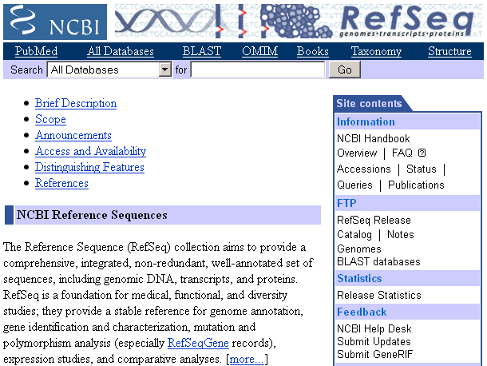
Genome references
A lot of genomes have already been sequenced.
In particular for Humans, there is already a high-quality reference (~3Gb)
This simplifies the analysis
November 13, 2012:
RefSeq Release 56 contains
data for 18,512 organisms.

Slide 6
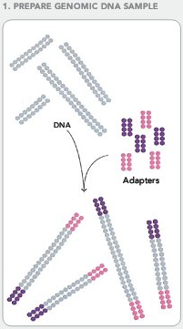
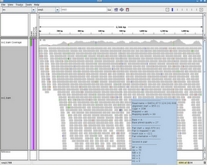
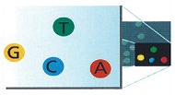
A typical sequencing data analysis pipeline
(3) Insertions/deletions
Sample prep
and sequencing
(2) Read mapping
(4) SNPs, smaller indels
(5) Copy number changes
Matching reads to a reference
Searching for mutations in the sample DNA

Slide 7
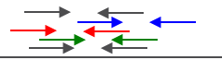
Read mapping
(2) Read mapping
Read Mapping Problem: Given a set of read sequences R, a reference sequence G, and a distance k.
Find all pairs (r;g) with r in R, g is substring of G and dist(r;g) < k.
Common distance measures are Hamming distance or edit distance.
The pairs (r;g) are called matches of r.
Some considerations
Alphabet is small (A,C,G,T)
We map short strings (100-250 letters) to a large one (Human reference genome is ~3Gb)
DNA strings to map contain errors (~ 3%)
Problem sizes are large (billions of DNA strings to 3Gb reference)
DNA is repetitive.

Slide 8
The Burrows-Wheeler Transform

Slide 9
Read mapping using the Burrows-Wheeler Transform
BWT-based text indexes are the core of popular mapping programs
Bowtie (Langmead et al.,Genome Biology 2009)
BWA (Li and Durbin, Bioinformatics 2009, 2010)
SOAP2 (Li et al., Bioinformatics 2009)
Create index from reference genome (e.g. human)
“create once, use many times”

Slide 10
Burrows-Wheeler Transform (B&W 1994)
AGACA$
GACA$A
ACA$AG
CA$AGA
A$AGAC
$AGACA
$AGACA
A$AGAC
ACA$AG
AGACA$
CA$AGA
GACA$A
T= AGACA $
BWT
All cyclic
permutations
Sort
Particular way of rearranging letters of a text:
Runs of same letters tend to group together and compresses well (using Run Length or Huffman encoding)
Original text can be reconstructed from BWT.
BWT can act as index of text using additional data structures (FM-index).
Can also be defined for a collection of strings.
Notes:
Take string, build all cyclic permutations, sort them. Last column = BWT string.

Slide 11
BWT construction
How to build it?
Naïve construction (building and sorting all cyclic rotations of T) is expensive.
Luckily, there is a related data structure, the suffix array (Manber & Myers 1990) for which linear-time construction algorithms exist.
SA-IS by Nong, Zhang & Chan (2009) is one of the fastest
There is a straightforward linear mapping from suffix arrays to the BWT.

Slide 12
Exact pattern matching in BWT (1): LF-mapping
F
L
$ AGAC A
A $AGA C
A CA$A G
A GACA $
C A$AG A
G ACA$ A
AGACA $
Last first (LF) mapping: the i^{th} occurrence of character c_{i} in the last column = same text character as the i^{th} occurrence of c_{i} in the first column.
Using this property (and some additional data structures), we can search the text for a pattern P.
Notes:
Introduce Q interval here.

Slide 13
Exact pattern matching in BWT (2): LF-mapping
C(c) := function that maps a character c to the total number of occurrences in T of the characters which are alphabetically smaller than c.
Occ(c,k) := function that maps (c; k) to the number of occurrences of c in the prefix L[1..k] of the transformed text L.
C, Occ and L (last column in BWT matrix) are called the FM index.
Example:
It then holds:
LF(i) = C(L[i]) + Occ(L[i]; i)
a | $ | A | C | G | T
na | 1 | 2 | 1 | 1 | 0
C | 0 | 1 | 3 | 4 | 5
T = AGACA $
Notes:
Introduce Q interval here.

Slide 14
Exact pattern matching in BWT (2): LF-mapping
LF(i) = C(L[i]) + Occ(L[i]; i)
F
L
$ AGAC A
A $AGA C
A CA$A G
A GACA $
C A$AG A
G ACA$ A
C and F can be obtained by sorting L
.
Occ(c,i) can be constructed using sequential scan over L but will be large.
Occ(c,i) (rank) queries will dominate runtime. Can choose not to store all entries at the expense of slow down. Or use Wavelet-trees (rank queries in log2|∑|)
Notes:
Introduce Q interval here.

Slide 15
Exact pattern matching in BWT (4): Q-intervals
BWT
Observation: characters of the BWT whose associated suffixes start with string Q form a contiguous interval.
We call this the Q-interval [b_{Q},e_{Q}].
A | $ AGAC A
C | A $AGA C
G | A CA$A G
$ | A GACA $
A | C A$AG A
A | G ACA$ A
Extending Q-intervals:
Each occurrence of c in the Q-interval corresponds to an occurrence of string cQ in the text (backward extension).
Notes:
Introduce Q interval here.

Slide 16
Exact pattern matching in BWT: “backward search”
$ AGAC A
A $AGA C
A CA$A G
A GACA $
C A$AG A
G ACA$ A
Locate suffixes starting with “A”.
Count occurrences of “G” in Q-interval.
Locate suffixes starting with “G” using LF-mapping (forward extension).
…
Query string P=GA
Count(P) in O(|P|)
Locate(P) in O(|P| + log |T|)
Need to store a selection of indices that map entries of L to T
Notes:
Introduce Q interval here.

Slide 17
Inexact Pattern matching
DNA sequencing is not a 100% accurate process, DNA reads will contain errors (mismatches).
To allow for mismatches, do backward search as usual. If Q-interval becomes empty, back track to the last matching suffix. Greedily substitute letter in the DNA read and continue.
Some similarity to a depth-first search. Not guaranteed to find the “best” match for the read, but most tools give the first N found.

Slide 18
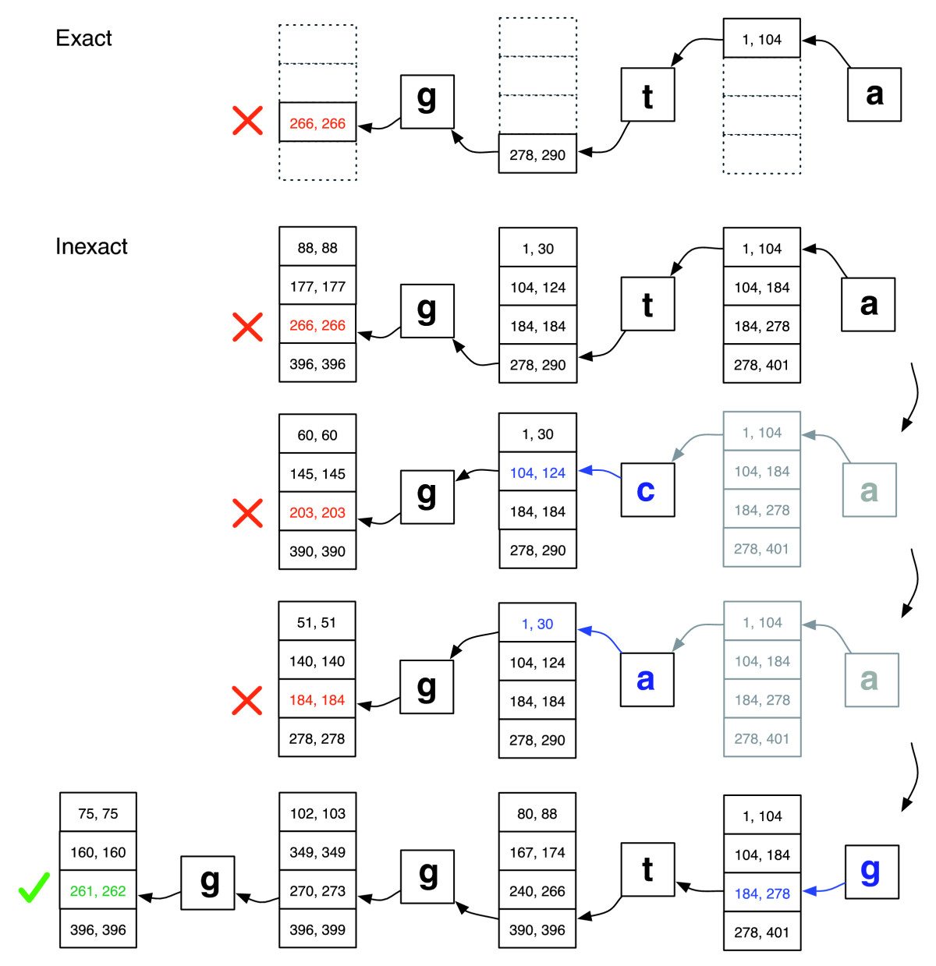
Inexact Pattern matching
Taken from Langmead et al (2009)

Slide 19
Compressing DNA data
Notes:
The first application is compression.
To explain this, we need to go into a bit more details on how BWT sorts data. Remember I told you BWT groups bases together according to their context.
For each base of each read, the context of a base is all the bases following it in the read. So for a read of size n, the context of base 1 is this n-1-mer, the context of base 2 is this n-2-mer, etc, until the context of base n, which is empty (we just mark it as a $ sign).
Similar contexts are grouped together simply by sorting all of them alphabetically. These contexts are in fact our index, but it is never stored on disk. What we store (and call BWT) is the bases associated to their context in this new order, and the magical property of BWT is that the contexts can be recovered by following the bases in a special way.
As the bases are ordered such as their suffixes are alphabetically ordered, when the contexts are sufficiently long, they will be unique in any genome and the bases will be the same multiple times. This results in the BWT being very well compressible.

Slide 20
Why does it work?
Suppose that some word, w=w₀...w_{k-1}, occurs frequently in T.
Suffixes starting w₁...w_{k-1}... will be sorted in a "block" and there will be a corresponding "run" of w₀ in BWT(S).
Same for suffixes starting w₂...w_{k-1}... and runs of w₁, and so on.
w=w₀...w_{k-1}
w’
w’’
w’’’
BWT
w₀
w₀
w₀

Slide 21
Do we really need a reference?
(3) Insertions/deletions
Sample prep
and sequencing
(2) Read mapping
(4) SNPs, smaller indels
(5) Copy number changes
Matching reads to a reference
Searching for mutations in the sample DNA

Slide 22
BWT of a human genome dataset
Typical dataset: 30-fold coverage of 3Gbase genome
= 100 billion bases of data
= 1 billion 100 base sequences
Existing methods need large amounts of either RAM (>600Gbytes) or CPU time (>1 CPU month).
New iterative algorithm¹ takes <20 CPU hours (SSD) and <0.1Gb RAM.
Key idea:
Basic idea: iteratively build the BWT for suffixes of the reads.
At each iteration, update with the current character
Allows us to keep the partial BWT on disk.
O(mlog(mk)) bits of space and O(k sort(m)) time (m strings of length k)
¹M. J. Bauer, A. J. Cox, G. Rosone, (2012) “Lightweight algorithms for constructing and inverting the BWT of string collections” Theoretical Computer Science.

Slide 23
Comparing two BWTs without a references
Task: given BWTs of two sets of reads R and G, find all string s that are
Present in R only
Present in G only
Present in both R and G
Can do this by making |s| sequential passes through BWT of G and BWT of R.
Sequential access – can read files from disk – no RAM needed.
“all-against-all backwards search”

Slide 24
BWT1 | suffixes | BWT2 | suffixes
T | $₁ | A | $₁
A | $₂ | T | $₂
C | A$₂ | C | A$₁
C | ACA$₂ | G | ACA$₂
C | ACAT$₁ | G | ACAT$₁
C | AT$₁ | $₁ | AGACA$₁
A | CA$₂ | C | AT$₂
T | CACA$₂ | A | CA$₁
$₁ | CACAT$₁ | A | CAT$₂
A | CAT$₁ | A | GACA$₁
T | T$₁ | $₂ | GACAT$₂
$₂ | TCACA$₂ | A | T$₂
CACAT, TCACA Sample 1 reads GACAT, AGACA Sample 2 reads

Slide 25
BWT1 | suffixes | BWT2 | suffixes
T | $₁ | A | $₁
A | $₂ | T | $₂
C | A$₂ | C | A$₁
C | ACA$₂ | G | ACA$₂
C | ACAT$₁ | G | ACAT$₁
C | AT$₁ | $₁ | AGACA$₁
A | CA$₂ | C | AT$₂
T | CACA$₂ | A | CA$₁
$₁ | CACAT$₁ | A | CAT$₂
A | CAT$₁ | A | GACA$₁
T | T$₁ | $₂ | GACAT$₂
$₂ | TCACA$₂ | A | T$₂

Slide 26
BWT1 | suffixes | BWT2 | suffixes
T | $₁ | A | $₁
A | $₂ | T | $₂
C | A$₂ | C | A$₁
C | ACA$₂ | G | ACA$₂
C | ACAT$₁ | G | ACAT$₁
C | AT$₁ | $₁ | AGACA$₁
A | CA$₂ | C | AT$₂
T | CACA$₂ | A | CA$₁
$₁ | CACAT$₁ | A | CAT$₂
A | CAT$₁ | A | GACA$₁
T | T$₁ | $₂ | GACAT$₂
$₂ | TCACA$₂ | A | T$₂

Slide 27
BWT1 | suffixes | BWT2 | suffixes
T | $₁ | A | $₁
A | $₂ | T | $₂
C | A$₂ | C | A$₁
C | ACA$₂ | G | ACA$₂
C | ACAT$₁ | G | ACAT$₁
C | AT$₁ | $₁ | AGACA$₁
A | CA$₂ | C | AT$₂
T | CACA$₂ | A | CA$₁
$₁ | CACAT$₁ | A | CAT$₂
A | CAT$₁ | A | GACA$₁
T | T$₁ | $₂ | GACAT$₂
$₂ | TCACA$₂ | A | T$₂
Divergent backward extension

Slide 28
BWT1 | suffixes | BWT2 | suffixes
T | $₁ | A | $₁
A | $₂ | T | $₂
C | A$₂ | C | A$₁
C | ACA$₂ | G | ACA$₂
C | ACAT$₁ | G | ACAT$₁
C | AT$₁ | $₁ | AGACA$₁
A | CA$₂ | C | AT$₂
T | CACA$₂ | A | CA$₁
$₁ | CACAT$₁ | A | CAT$₂
A | CAT$₁ | A | GACA$₁
T | T$₁ | $₂ | GACAT$₂
$₂ | TCACA$₂ | A | T$₂
Further evidence in
subsequent Iterations.

Slide 29
Tasmanian devil population decline
Tasmanian devil facial tumour disease (DFTD) : first observed in 1996, spreading rapidly through the Tasmanian devil population.
Clonally transmissible cancer spread by the physical transmission of cancerous cells. Causes death of their hosts within months.
Devil population has declined by >80% across Tasmania.
Extinction in wild predicted within 25 years.
Sequenced tumour RNA+DNA samples from several animals across Tasmania to trace development of the cancer
Collaboration with Elizabeth Murchison (University of Cambridge)
Published in Murchison et al (2012) Cell

Slide 30
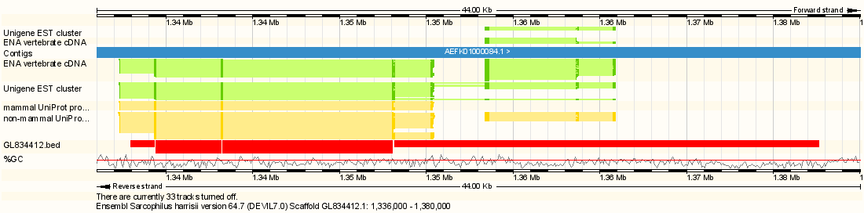

Using the BWT to find RNA splice junctions
Prediction obtained by directly comparing BWT of RNA and DNA reads (without reference).
Strong signal, but no database entry.

Slide 31
Acknowledgements
Computational Biology Illumina UK
Anthony Cox
Lilian Janin
Giovanna Rosone (University of Palermo)
Markus Bauer (now at Boehringer Ingelheim)
Research group for Algorithmic Bioinformatics, Free University Berlin
Knut Reinert
David Weese
Checkout BEETL (Burrows-Wheeler Extended Tool Library)
https://github.com/BEETL/BEETL

